Slide 1
Image Classification using Convolutional Neural Networks
Team Members:
Mai Tarek 201401578
Shrouk Shalaby 201400455
Yomna Shreif 201401302

Slide 2
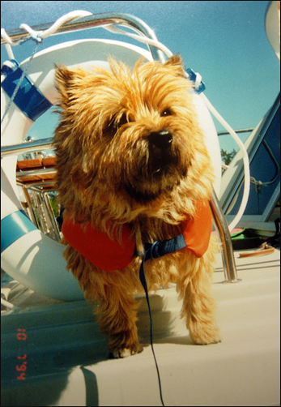
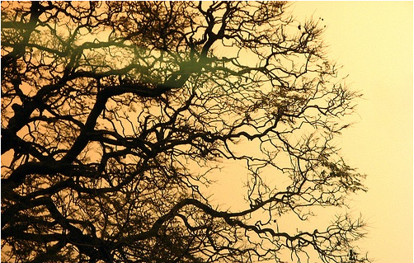
Project Idea
Image classification for the most general objects found on the street like cars, busses, traffic signs,humans---- etc .

Slide 3
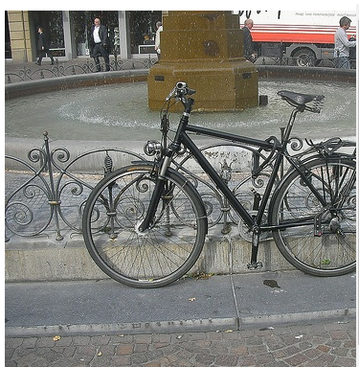
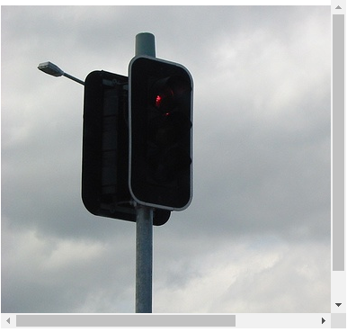
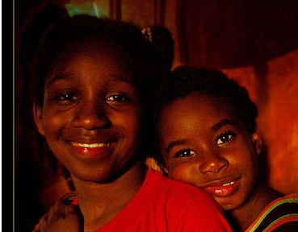
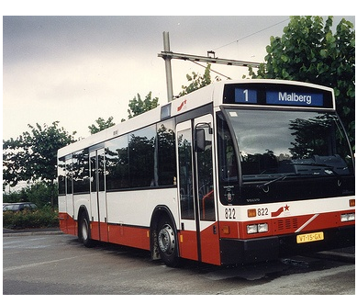
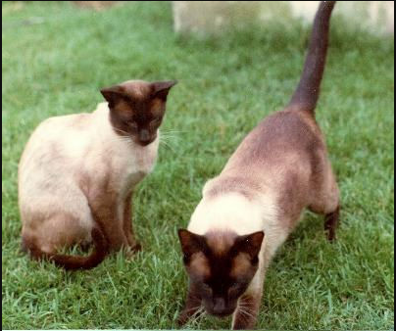
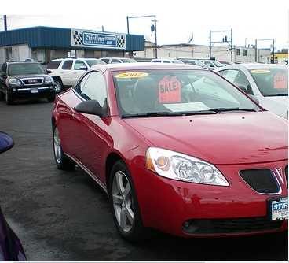

Slide 4
Dataset and Method(CNN)
No. of classes 8
cars, busses, dogs, cats, traffic signs,humans,bicycles and motorcycle

Slide 5
Expected Challenges
Processing Time will be very large
Datasets are very large in size

Slide 6
Algorithm
Downloading the dataset from ImageNet
1 Gather the id of the synsets
2 Get the list of URLs for the images of the synset
3 Split the urls and store them on a list

Slide 7
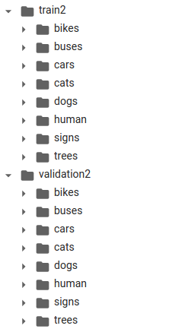
Algorithm
Downloading the dataset from ImageNet
4 Create directories (Training & Validation)
on the Google Colaboratory file system
5 Correct the images shape, format,
and store them on the corresponding directory

Slide 8
Algorithm
Building the model
Model Architecture
conv2d----Maxpooling---Dropout---flatten---dense
No. of filters
Optimizer
No. of epoch
Size of image

Slide 9
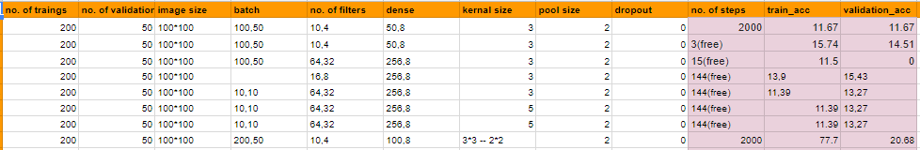
Results

Slide 10
Editing the data
Remove corrupted images from training and validation sets

Slide 11
Final model
No of training images : 400 for each class No of validation images : 100 for each class
Image size : 70 * 70 pixels

Slide 12
Final model structure
Convolutional Layer with 40 filters , kernel size=(3,3) , padding= ‘same’
Batch normalization
Max pooling , (2,2)
Dropout(0.25)
Convolutional Layer with 20 filters , kernel size=(3,3)
Batch normalization
Max pooling , (2,2)
Dropout(0.25)
Dense(200)
Dropout(0.5)
Dense(8 , ‘softmax’)

Slide 13
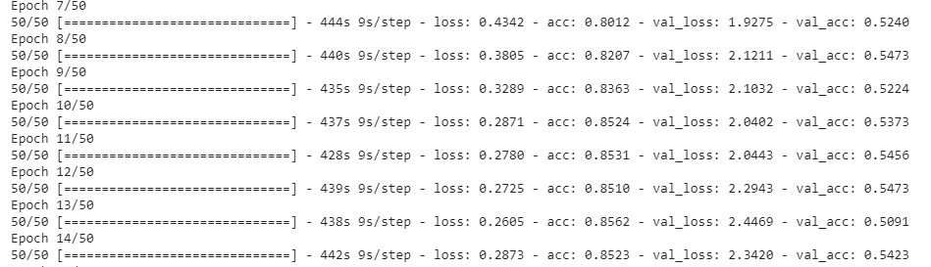
Results

Slide 14
Using different dataset (cifar10)
No. of imagges -------------------> 60000
Size of each image -------------> 32x32 colour images
No. of classes ---------------------> 10 (6000 per class)
(airplane-automobile-bird-cat-deer-dog-frog-horse-ship-truck)
No. Training images ------------> 50000
No. of validation images -----> 10000

Slide 15
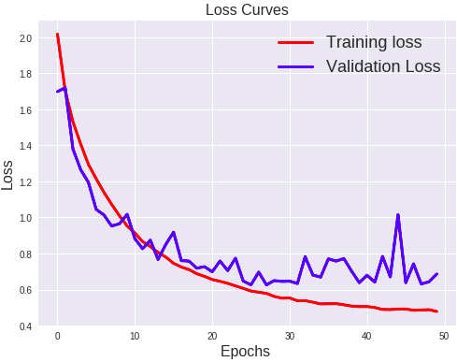
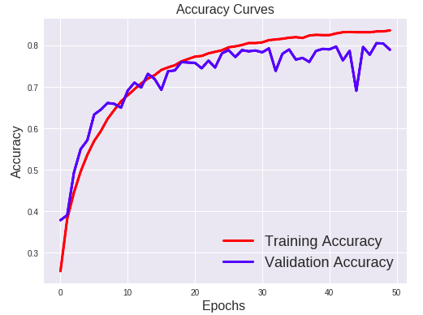
Results
Loss curve
Accuracy curve

